Slide 1
Inequality and Happiness Prediction
Derien Weatherspoon, Hailey Purcell, Celia Murphy

Slide 2
Outline
GINI index
The World Happiness Report
Country Coordinates
Predict Happiness and GINI index scores
Determine best model and features for prediction
Notes:
GINI index data set contained values from 1967 to 2021 for 165 separate countries. The GINI index is a measure of income inequality on a 0-1 scale.
The coordinate data set contained latitude, longitude, country, and country code information.
The World Happiness Report data was contained in 8 year separated datasets from 2015-2022 for 157 countries. The Happiness index is a quality of life measure calculated from a number of other variables.
We wanted to predict happiness and gini index values for countries past present and future

Slide 3
Feature Engineering
Target Variables:
Happiness Score
GINI Inequality Value
Features:
Gross Domestic Product
Social Support
Life Expectancy
Freedom of Choice
Generosity of the Public
Trust in Government
Latitude
Longitude
Notes:
Found and matched inconsistent country names between the 3 data sets.
Added year columns to each of the individual happiness datasets, removed unwanted and inconsistent features (world region, ladder score, dystopia, residuals, country code, etc.), renamed and repositioned desired variables.
We used rbind to join all of the happiness data, then matched names between the happiness and gini data sets, and removed countries that were not in both sets. Used SQL to join the happiness data, gini index data, and coordinate data on country name and year.
The end result was a singular data set containing country names, gini value, happiness score, gdp, social support, life expectancy, freedom, generosity, trust, latitude, and longitude for the years of 2015-2021. From here, the quality of the remaining features was checked. Trust was converted to double and the single NA value was imputed with the mean trust value.

Slide 4
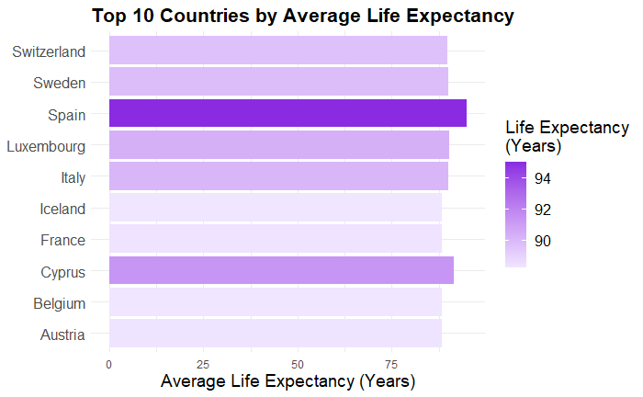
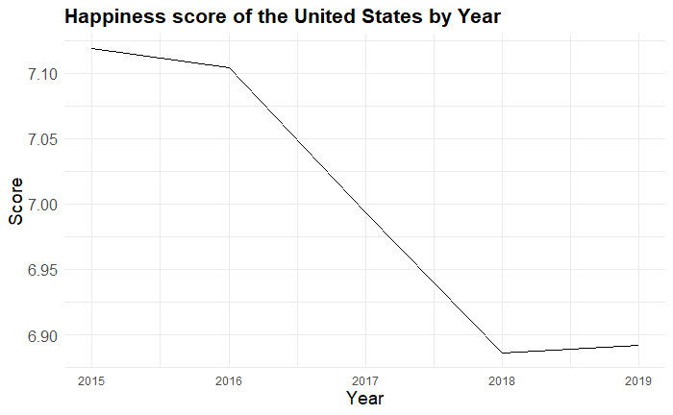
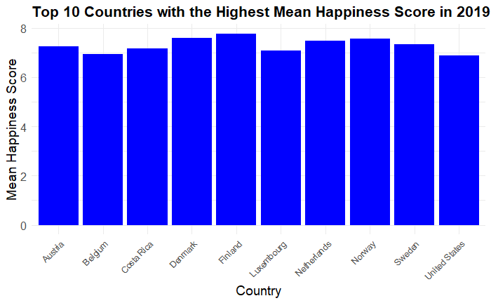
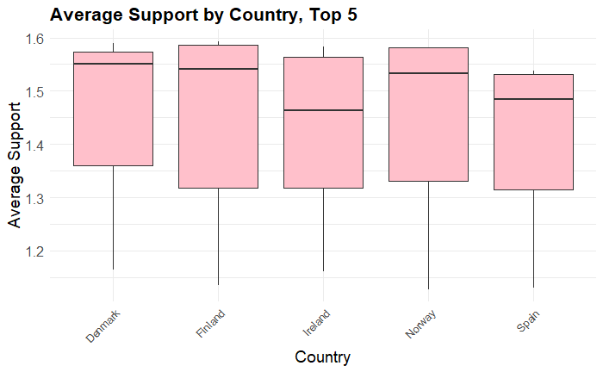
Visualizing the dataset
Notes:
To show our new dataset we made a few graphs to visualize the data and what we will be comparing
First is life expectancy, taken as an average for each year we have available data and we have a bar plot showing the ten countries with the highest life expectancy
Then we have the happiness score from the world happiness index. We used pre-covid data from 2019 to show the top 10 countries with the highest happiness score
We also can compare year-by-year, so we have a line graph showing happiness in the United States by comparing the score for each year
Another thing our new dataset shows is data that may affect the happiness score, so here we’re showing the countries with the highest levels of support through the years

Slide 5
How is each country’s happiness index affected by features used in our data set?
Notes:
Response variable is “score”. When building models, hold off on using country/country_code until the heatmap.

Slide 6
Exploratory Data Analysis
Histogram for response
Correlation Matrix
  Created plots for the 4 most correlated
Notes:
For the one NA value in trust, we imputed it with the median. Created histograms for response frequencies. Made correlation plot.

Slide 7
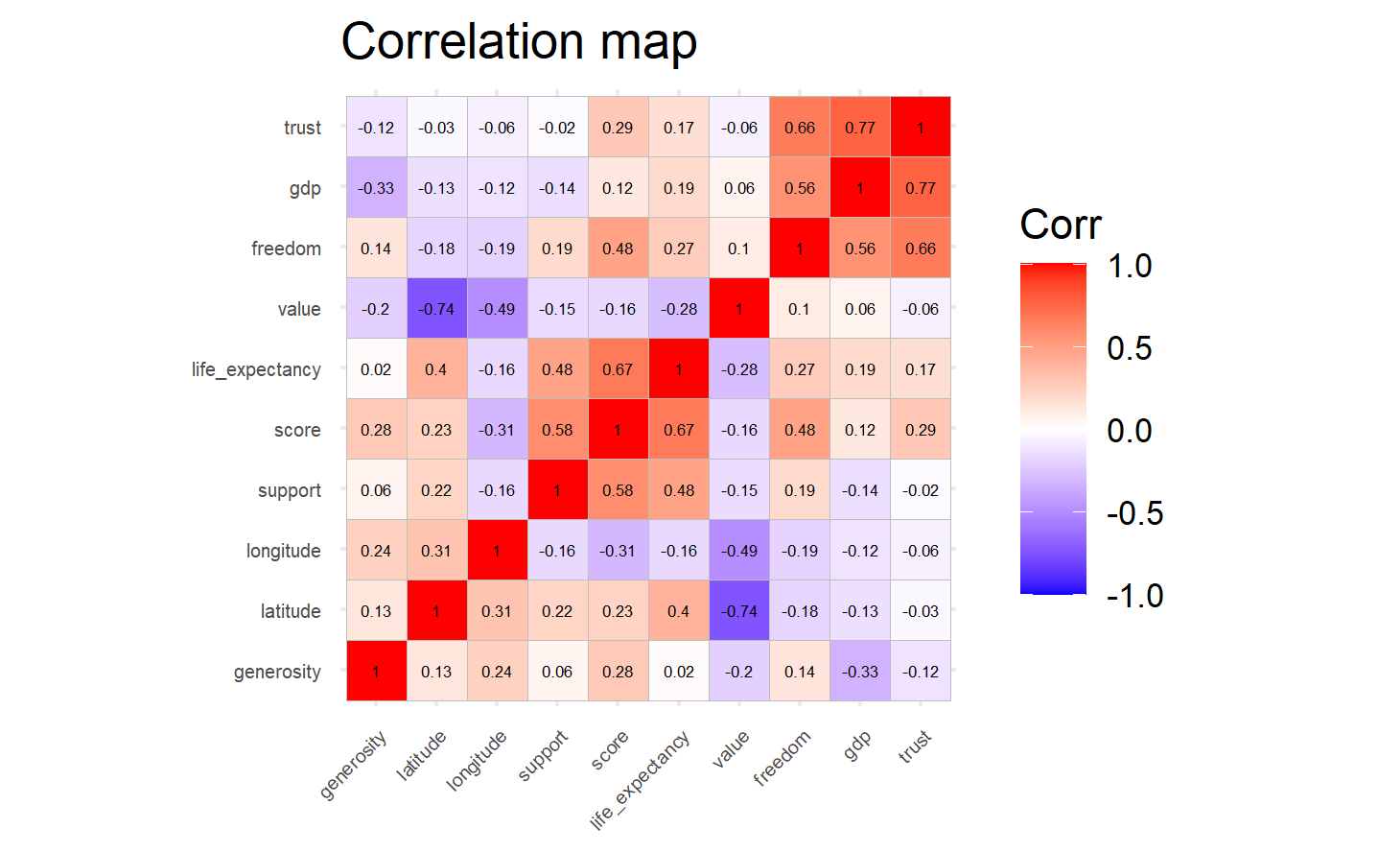
Notes:
Features most correlated with score are life_expectancy, support, freedom, longitude.

Slide 8
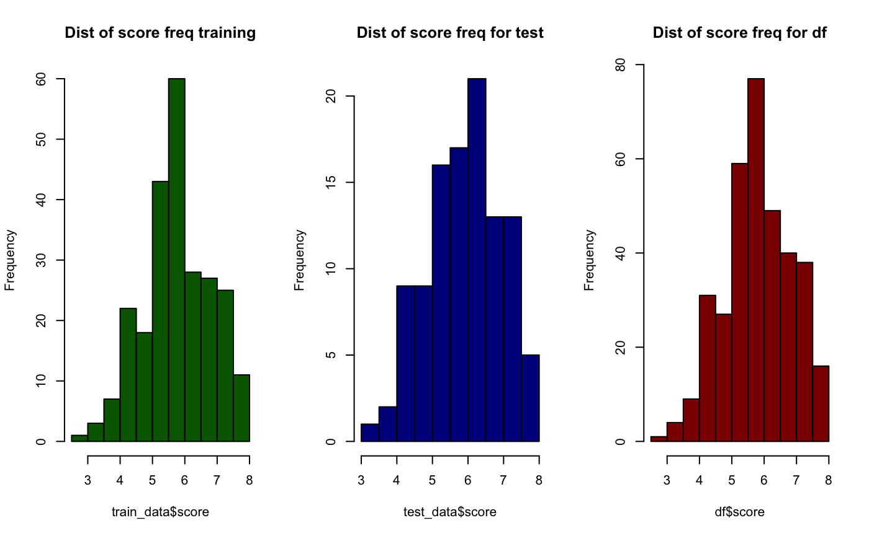
Notes:
Distribution for score values are pretty normally distributed. This means we will not be applying a log distribution.

Slide 9
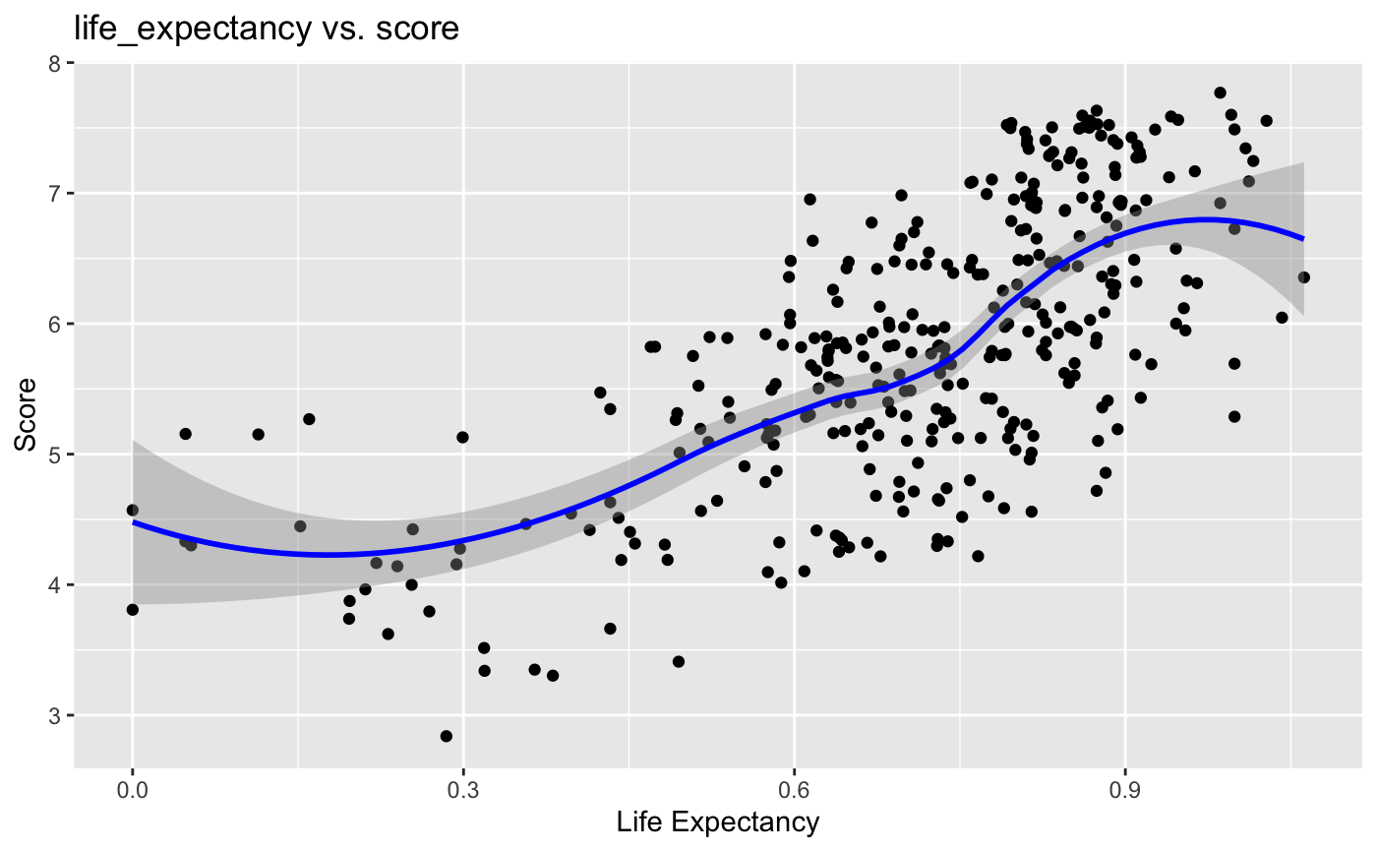
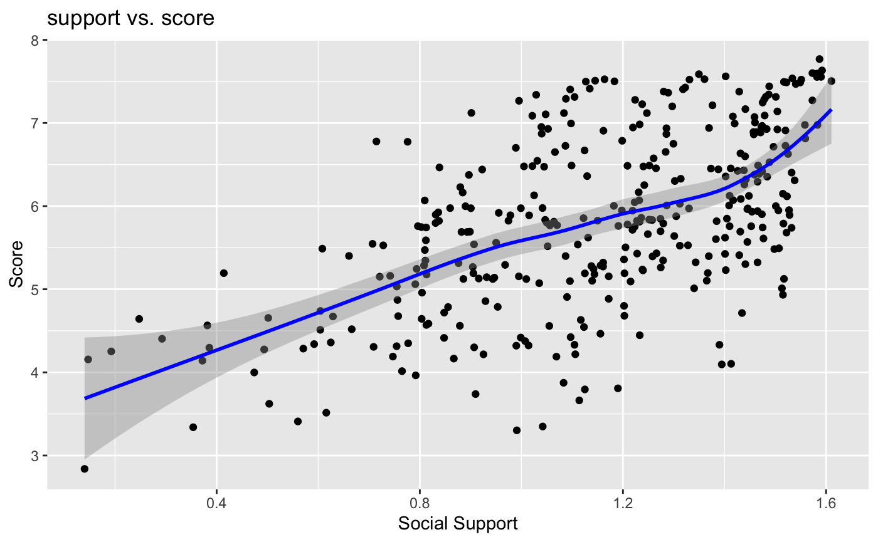
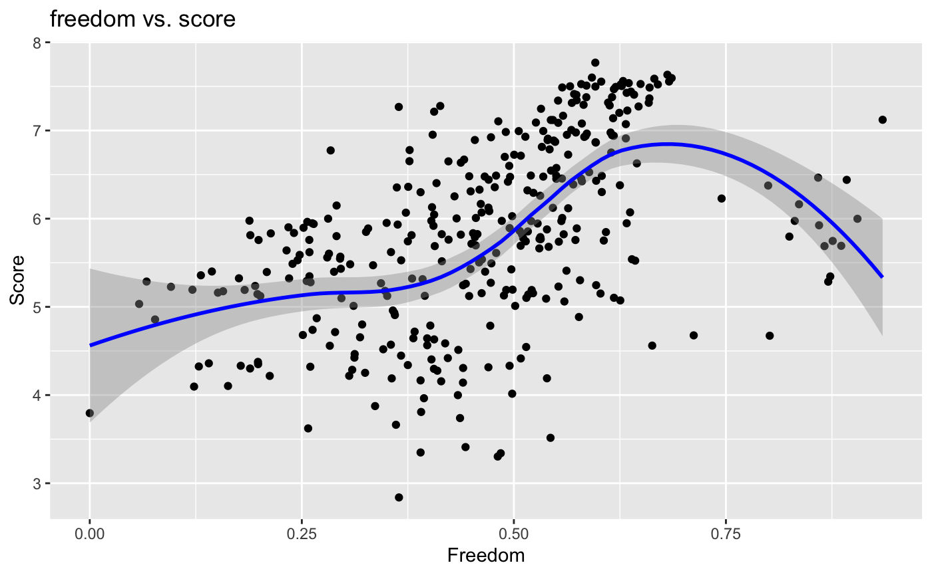
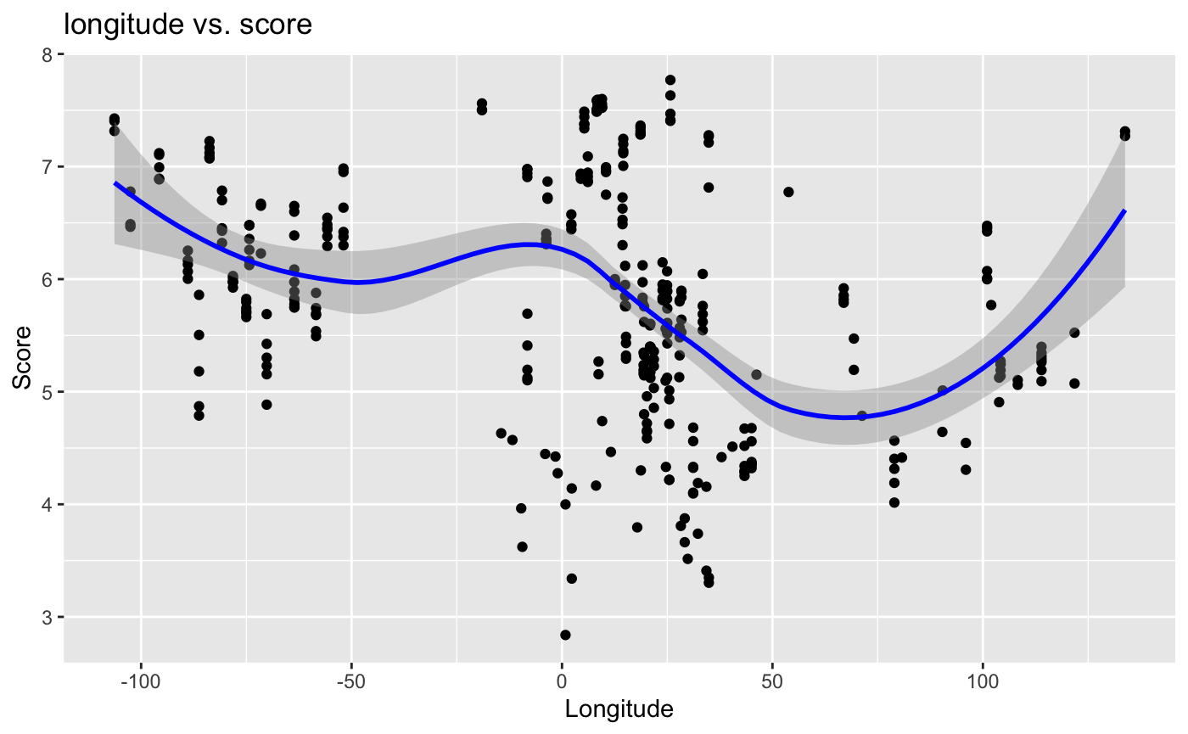
Notes:
Social Support is the 2nd most correlated, but has the best line of best fit. Longitude has a weak negative correlation with score, so that could explain its shape. Also, longitude is not a linear factor. Life expectancy makes sense, it seems as if the higher the life expectancy, the better the happiness index. This could be due to a multitude of factors.

Slide 10
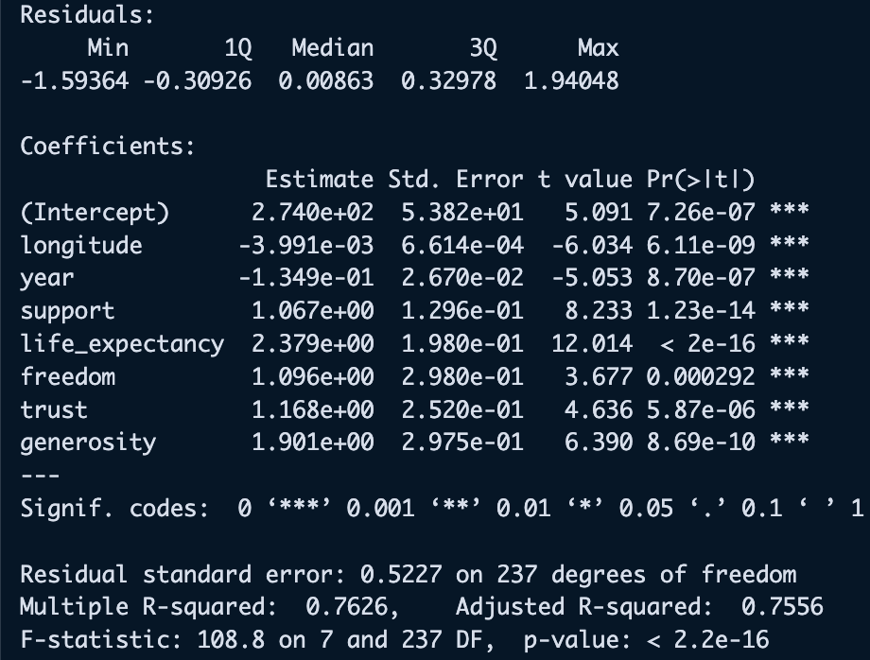
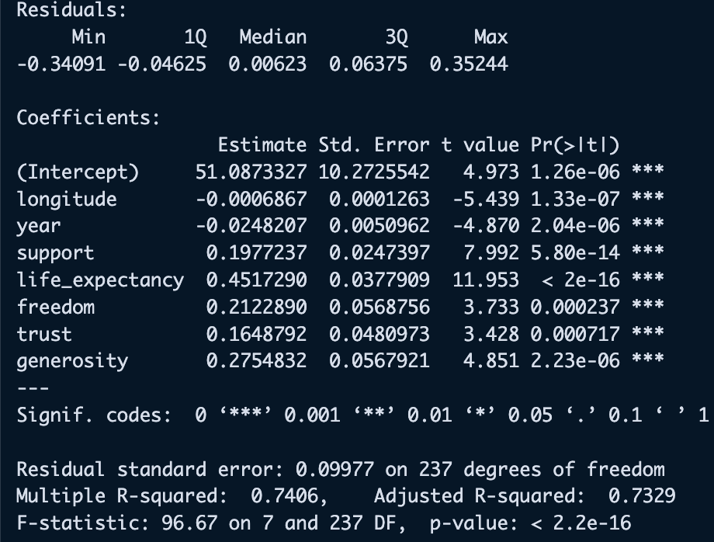
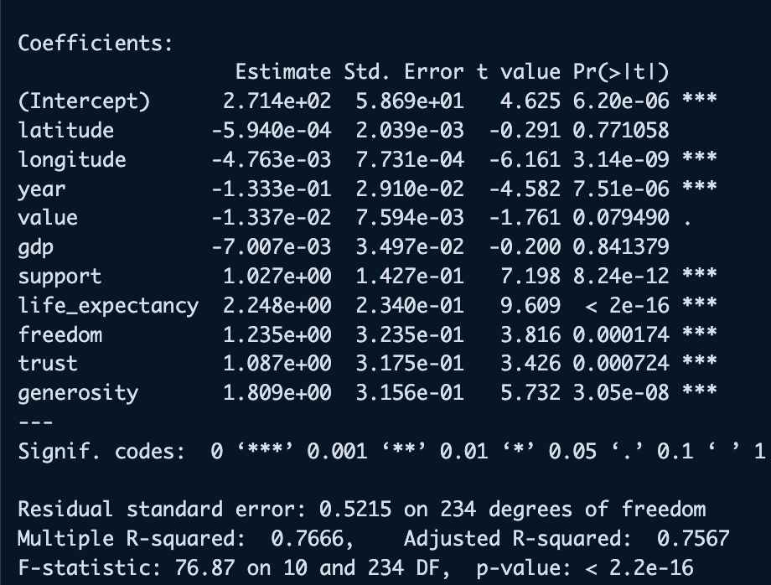
Regression modeling + Results
We tried 5 different regression models for this data.
3 linear regression models, 1 selection model, 1 shrinkage method.
Linear Model 1: All variables
Linear Model 2: Only significant variables
Linear Model 3: Significant variables + log transformation on response
Selection Model: Forward Stepwise Selection
Shrinkage Method: Lasso Regression
Lm2&3
lm1
Notes:
Try 4 different linear models, 3 linear models. One with all factors and no transformations, one with only significant factors included, and one with the significant factors included, along with a log transformation on the response. The 4th model is a forward stepwise model (BIC criterion), which produced the same values as linear model 1. Mention I did lasso Regression. Produced similar results to lm2

Slide 11
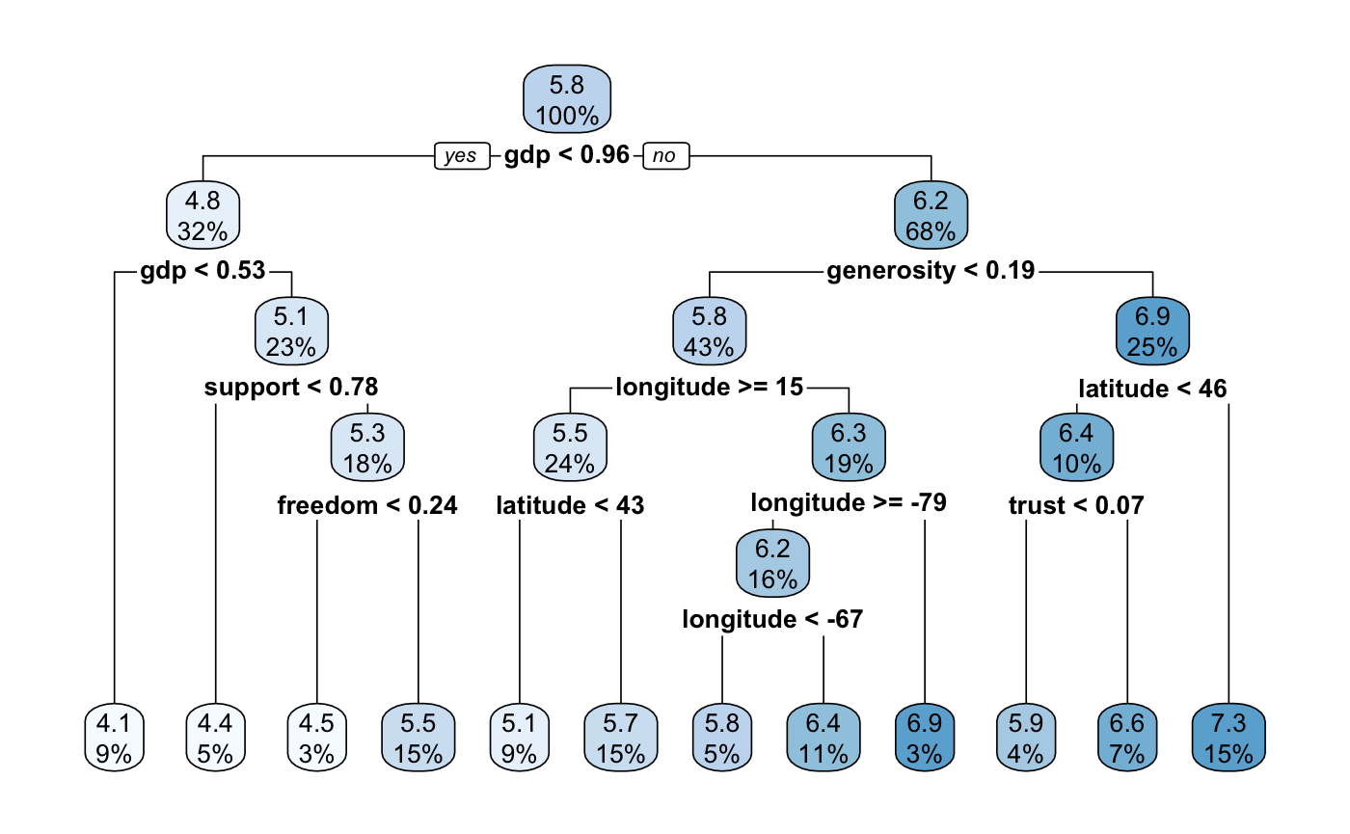
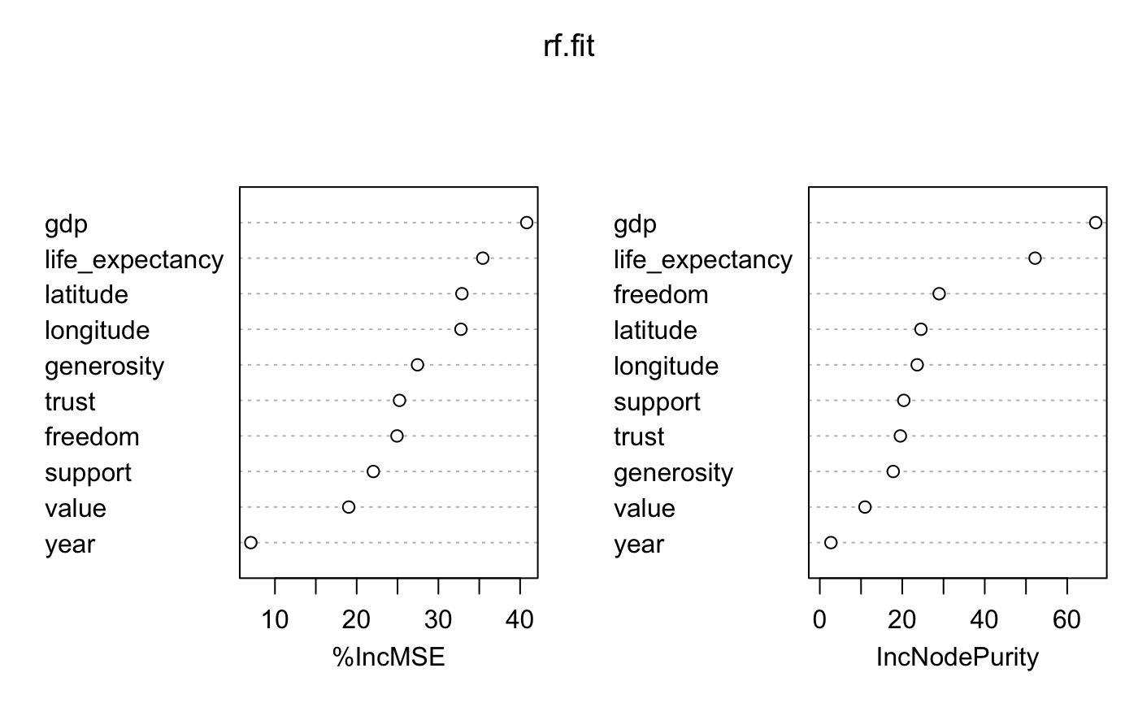
Tree modeling + Results
We tried 2 tree-based methods.
Decision Tree
  Tree used 8 predictors and had 12 terminal nodes
  support, gdp, freedom, generosity, longitude, latitude, trust, life_expectancy
Random Forest
  1000 trees
  mtry = 3
Notes:
According to the decision tree, it looks like gdp has the most importance when determining happiness score. This also makes sense when looking at the Random Forest importance plots, gdp is the most important when going for mse.

Slide 12

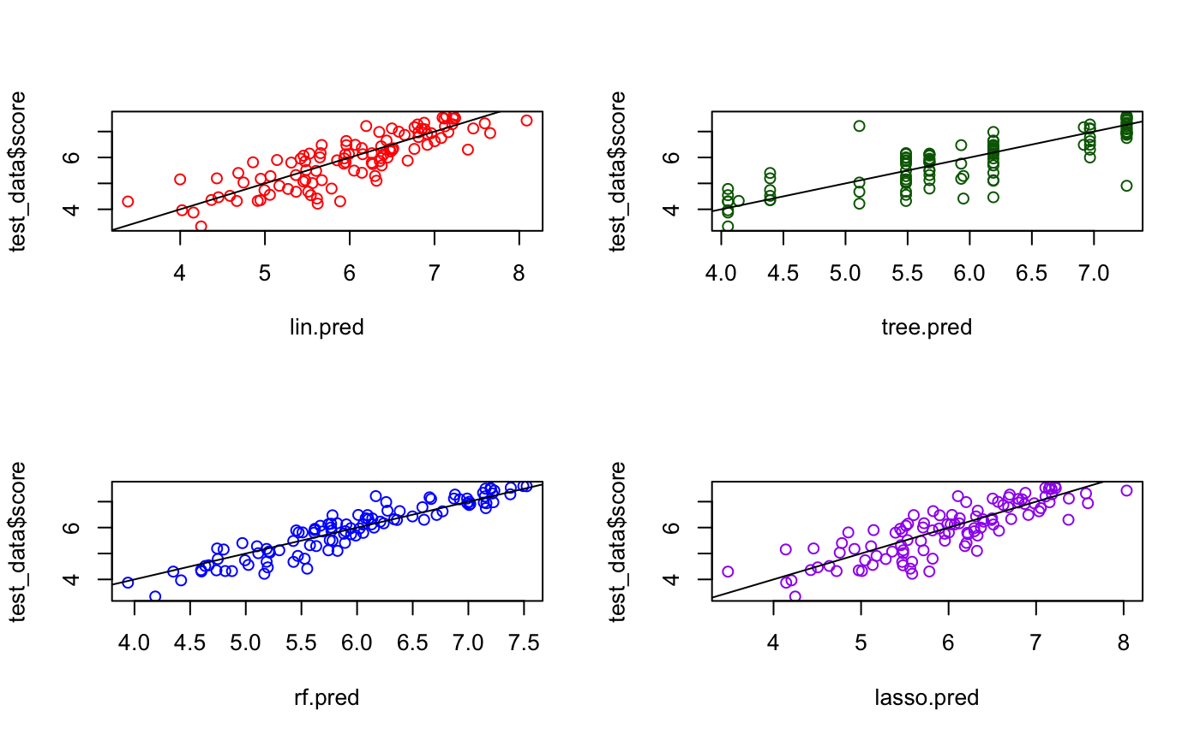



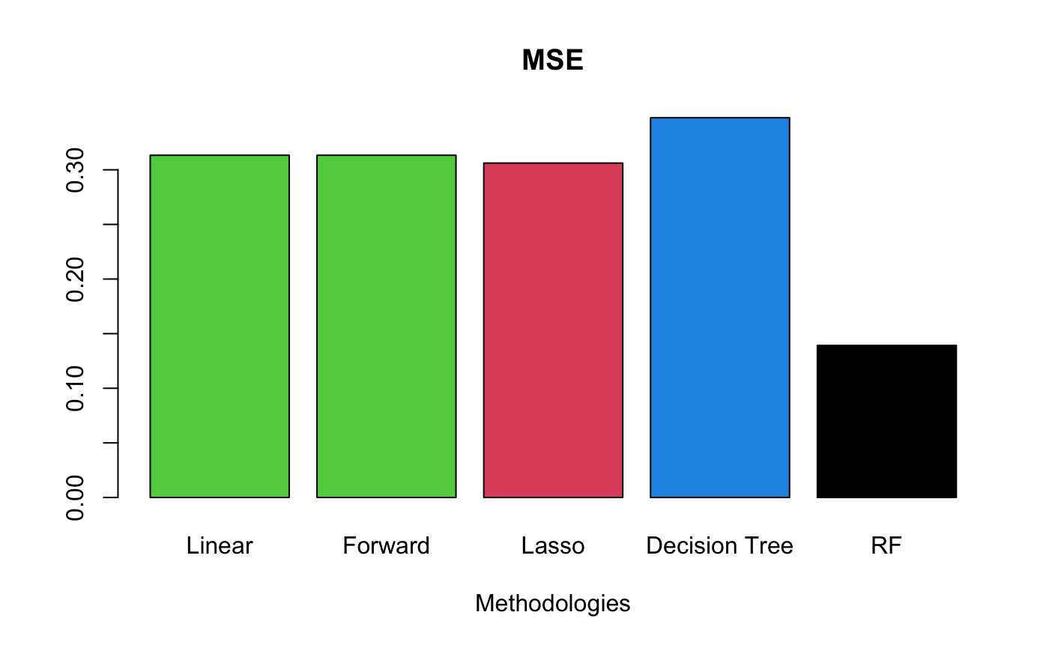
Predictions + Mean Squared Errors
Notes:
Random Forest model had the best line of fit, best predictions, and best MSE.

Slide 13
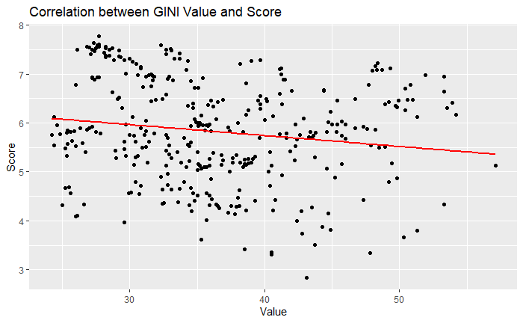
How does inequality affect happiness?
Contrary to what we predicted, the GINI inequality value for each country had a weak correlation with that countries happiness score
  -0.16
Variables like life expectancy, freedom, and support had much stronger correlations

Slide 14
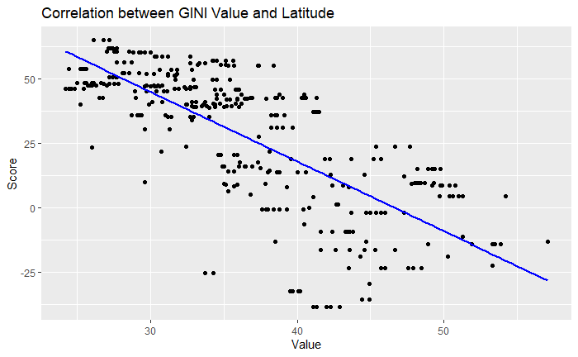
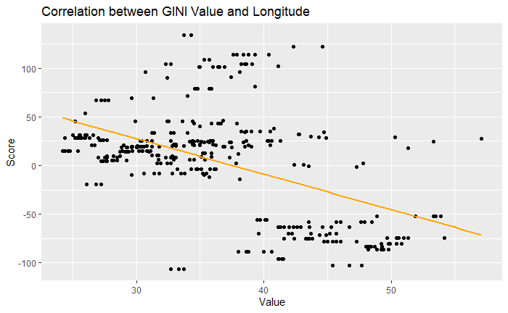
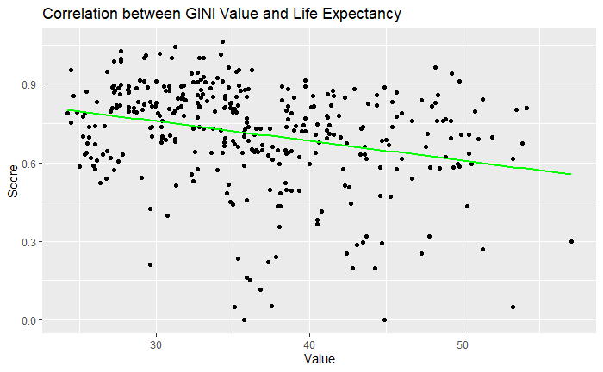
Factors correlated with inequality
Strongest correlations: latitude, longitude, and life expectancy

Slide 15
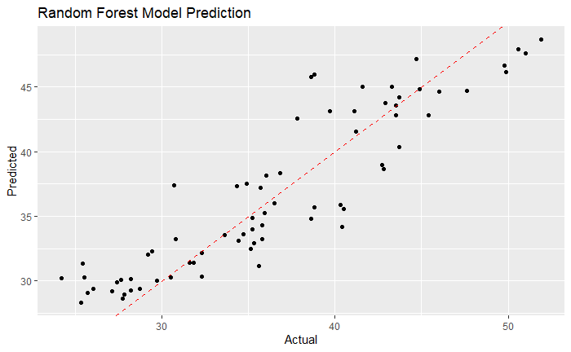
Predicting GINI
Using random forest, decision tree modeling, and linear regression
  Random Forest MSE: 9.519161
  Random Forest R-squared: 0.8193788
  Tree MSE: 23.32425
  Tree R-squared: 0.5524749
  Linear MSE: 20.42504
  Linear R-squared: 0.6171535

Slide 16
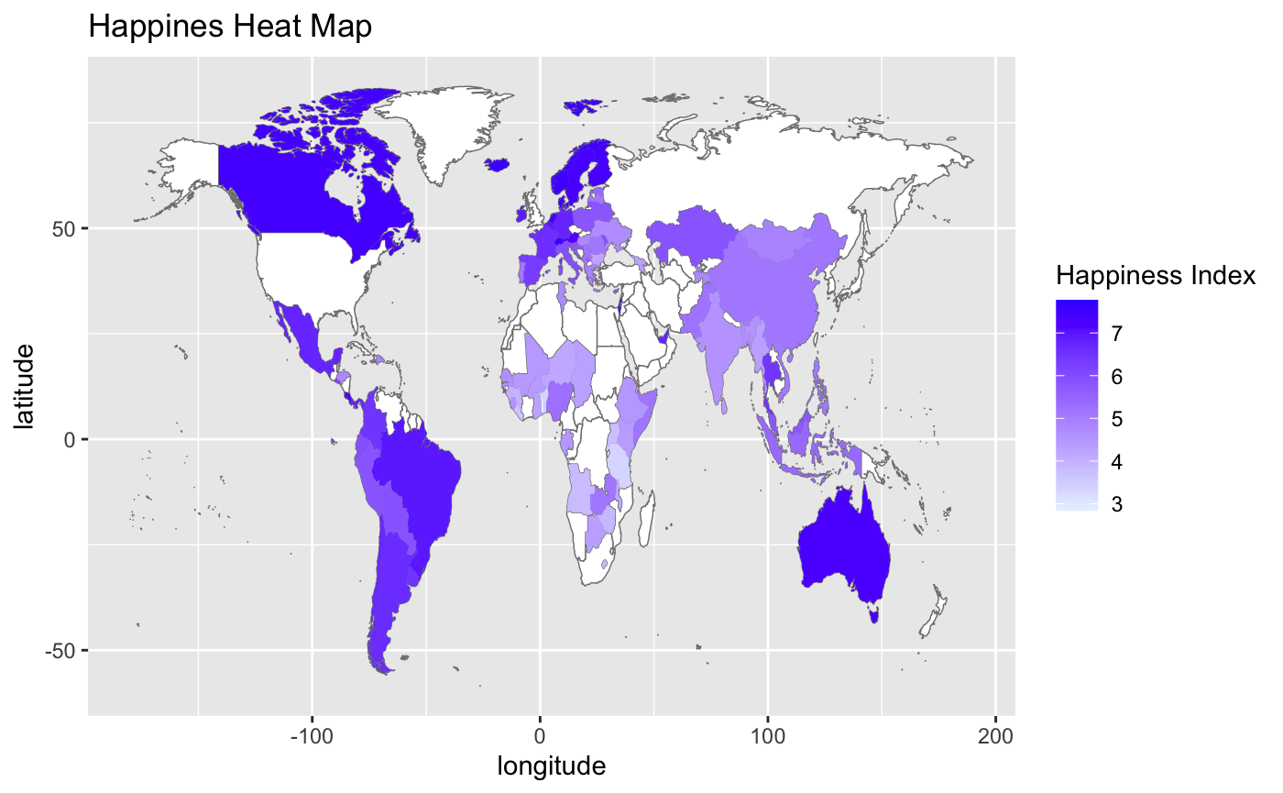
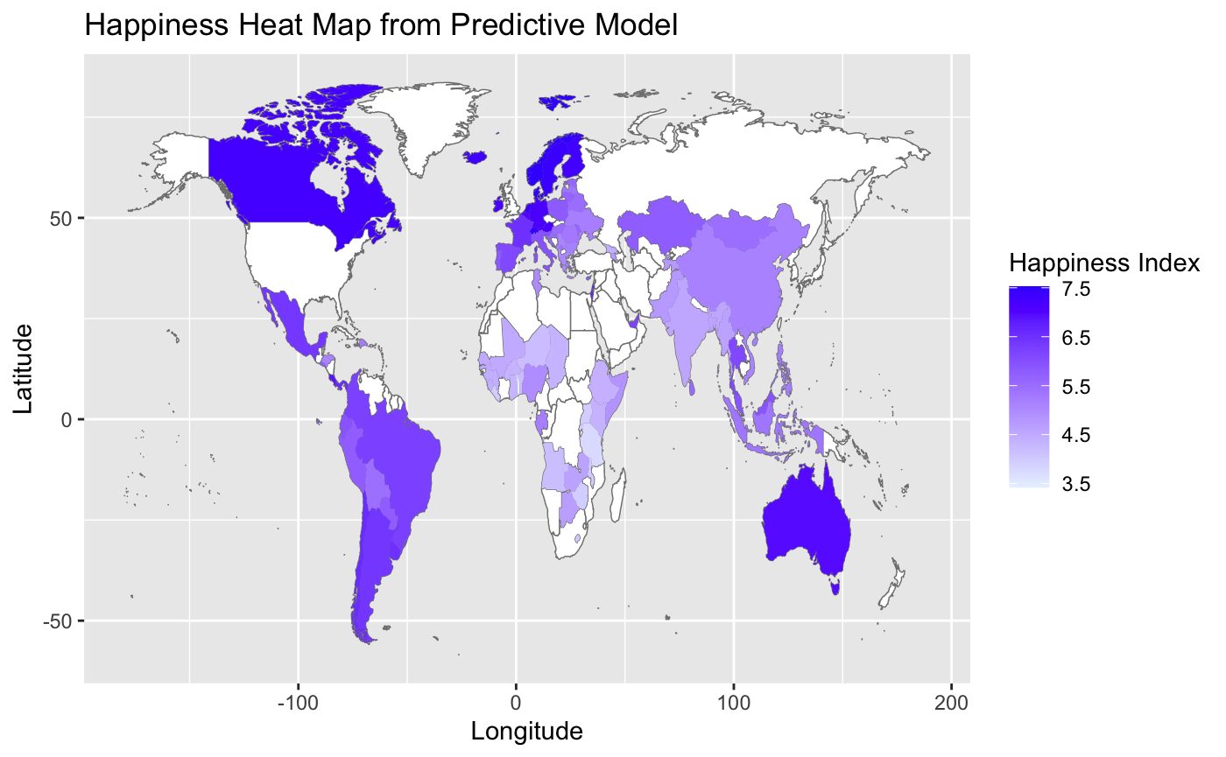
Conclusions
The random forest model was the best overall predictor despite higher variance
Strongest Features
Notes:
The random forest model was the best overall predictor despite having higher variance than the other models. The baseline linear model was a close second.
Longitude, year, Support, LIfe expectancy, freedom, trust, and generosity were the best features

Slide 17
Questions?

